Slide 1


Slide 2

PROJECT OVERVIEW

Slide 3
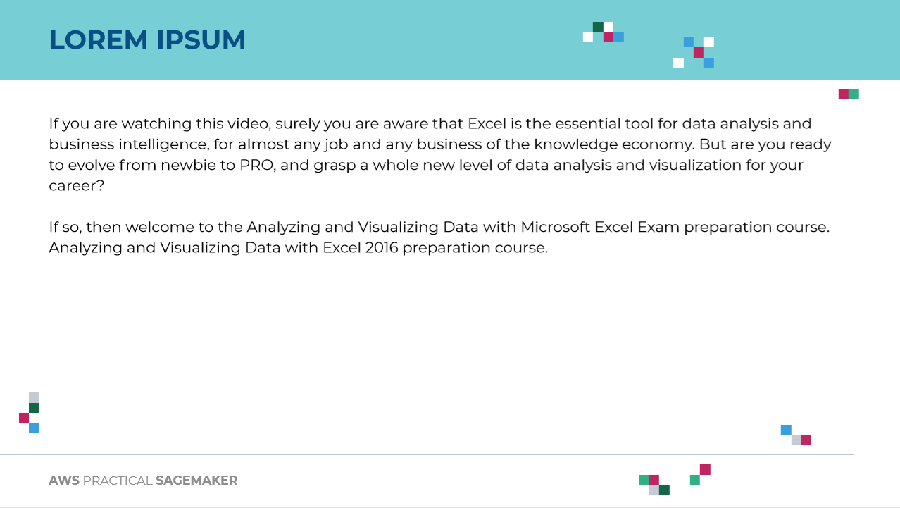
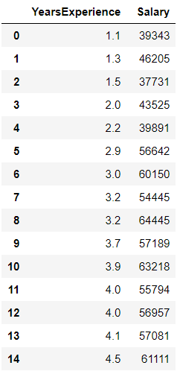

PROJECT OVERVIEW
The objective of this case study is to predict the employee salary based on the number of years of experience.
TRAINING DATASET
(COLLECTED FROM HUMAN RESOURCES DEPARTMENT)
Source: https://publicdomainvectors.org/en/free-clipart/Employee-search-concept/83802.html
Data Source: https://www.kaggle.com/rohankayan/years-of-experience-and-salary-dataset

Slide 4
PROJECT OVERVIEW
The final outcome of this project is to come up with a linear regression model that could accurately predict employee salary based on number of years of experience.
$40,000
NUMBER OF YEARS OF EXPERIENCE
REGRESSION MODEL
SALARY
SALARY
TRAINING DATASET
(COLLECTED FROM HUMAN RESOURCES DEPARTMENT)
3 YEARS
YEARS OF EXPERIENCE
Source: https://publicdomainvectors.org/en/free-clipart/Employee-search-concept/83802.html

Slide 5
SIMPLE LINEAR REGRESSION

Slide 6
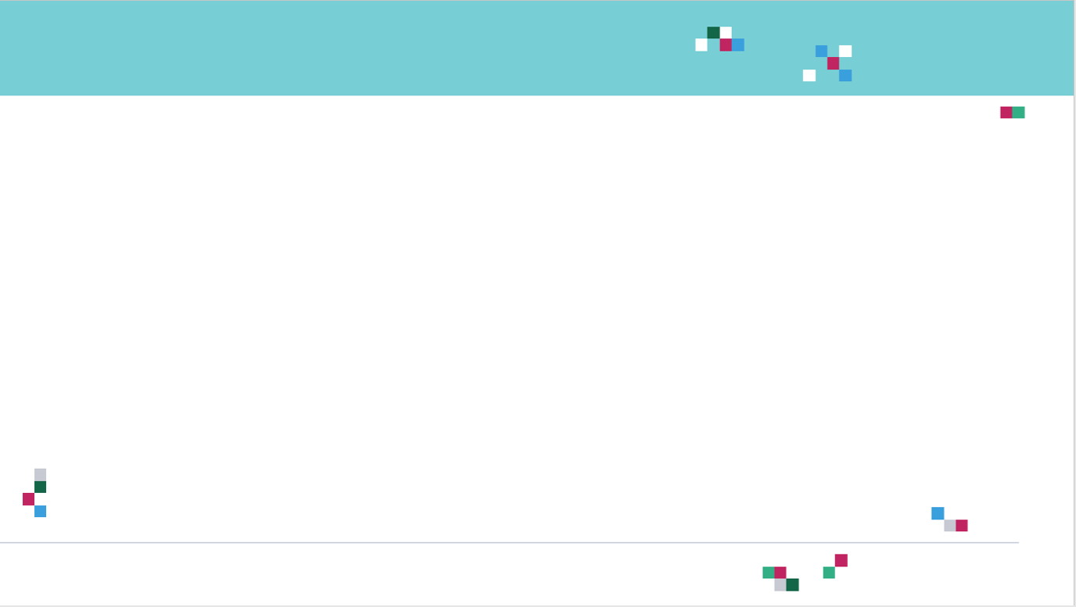
SIMPLE LINEAR REGRESSION: INTUITION
In simple linear regression, we predict the value of one variable Y based on another variable X.
X is called the independent variable and Y is called the dependant variable.
Why simple? Because it examines relationship between two variables only.
Why linear? when the independent variable increases (or decreases), the dependent variable increases (or decreases) in a linear fashion.
SALARY
YEARS OF EXPERIENCE
6

Slide 7

SIMPLE LINEAR REGRESSION: SOME MATH!
Goal is to obtain a relationship (model) between employee salary and number of years of experience.
MODEL! (GOAL)
SALARY($)
$$y=b+m∗x$$
$20K
DEPENDANT VARIABLE
SALARY ($)
INDEPENDENT VARIABLE
NUMBER OF YEARS OF EXPERIENCE
+5 years
NUMBER OF YEARS OF EXPERIENCE

Slide 8





WHAT’S M AND B?
Once the coefficients m and b are obtained, you have obtained a simple linear regression model!
This “trained” model can be later used to predict any salary based on the number of years of experience.
$$\text{y}\text{ = }\text{mX}\text{+}\text{b}$$
$$Y$$
$$m$$
DEPENDANT
VARIABLE
INDEPENDANT
VARIABLE
$$b$$
$$X$$

Slide 9






SIMPLE LINEAR REGRESSION: QUIZ
Match the equations to the figures:
$$y=3∗x$$
$$y=15−10∗x$$
$$y$$
$$y$$
$$x$$
$$x$$

Slide 10
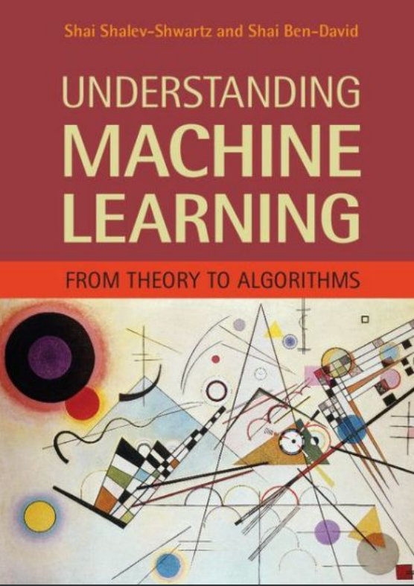
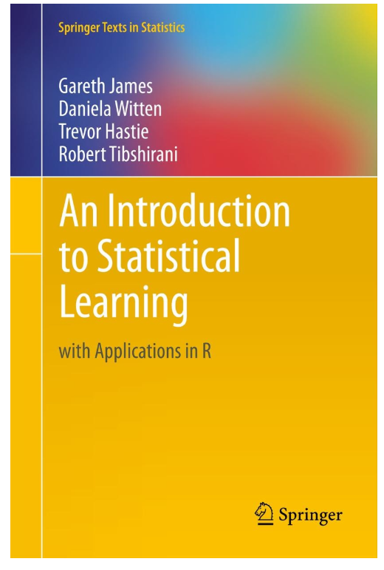
SIMPLE LINEAR REGRESSION: ADDITIONAL READING MATERIAL
Additional Resources, Page #123: http://www.cs.huji.ac.il/~shais/UnderstandingMachineLearning/understanding-machine-learning-theory-algorithms.pdf
Additional Resources, Page #61:
http://www-bcf.usc.edu/~gareth/ISL/ISLR%20Seventh%20Printing.pdf

Slide 11
LEAST SUM OF SQUARES

Slide 12
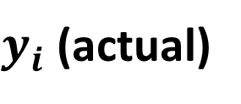


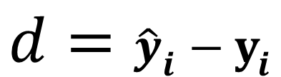
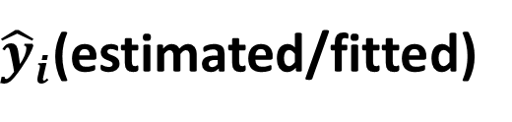
SIMPLE LINEAR REGRESSION: HOW TO OBTAIN MODEL PARAMETERS? LEAST SUM OF SQUARES
Least squares fitting is a way to find the best fit curve or line for a set of points.
The sum of the squares of the offsets (residuals) are used to estimate the best fit curve or line.
Least squares method is used to obtain the coefficients m and b.
$y_{i}$ (actual)
$$d$$
$$d={\hat{y}}_{i}−y_{i}$$
SALARY ($)
${\hat{y}}_{i}$(estimated/fitted)
$$min\sum{{\left({\hat{y}}_{i}−y_{i}\right)}^{2} }$$
NUMBER OF YEARS OF EXPERIENCE
MINIMUM (LEAST) SUM OF SQUARES

Slide 13
SIMPLE LINEAR REGRESSION: TRAINING VS. TESTING DATASET
Data set is divided into 75% for training and 25% for testing.
Training set: used for model training.
Testing set: used for testing trained model. Make sure that the testing dataset has never been seen by the trained model before.
75 TRAINING SAMPLES
100 SAMPLES
25 TESTING SAMPLES

Slide 14
SIMPLE LINEAR REGRESSION: ADDITIONAL READING MATERIAL
Additional Resources, Page #124: http://www.cs.huji.ac.il/~shais/UnderstandingMachineLearning/understanding-machine-learning-theory-algorithms.pdf
Additional Resources, Page #62:
http://www-bcf.usc.edu/~gareth/ISL/ISLR%20Seventh%20Printing.pdf

Slide 15
LINEAR LEARNER IN SAGEMAKER

Slide 16
SAGEMAKER LINEAR LEARNER: OVERVIEW
Linear Learner is a supervised learning algorithm that is used to fit a line to the training data.
It could be used for both classification and regression tasks as follows:
Regression: output contains continuous numeric values
Binary classification: output label must be either 0 or 1 (linear threshold function is used).
Multiclass classification: output labels must be from 0 to num_classes - 1.
The best model optimizes either of the following:
For regression: focus on Continuous metrics such as mean square error, root mean squared error, cross entropy loss, absolute error.
For classification: focus on discrete metrics such as F1 score, precision, recall, or accuracy.
SALARY
YEARS OF EXPERIENCE

Slide 17
SAGEMAKER LINEAR LEARNER: USE CASES
DISCRETE BINARY CLASSIFICATION
Does this patient have a disease or not?
DISCRETE MULTICLASS CLASSIFICATION
Should an autonomous car stop, slow down or accelerate?
REGRESSION TASKS
Revenue predictions based on previous years performance.

Slide 18
SAGEMAKER LINEAR LEARNER: OVERVIEW
Preprocessing
Ensure that data is shuffled before training
Normalization or feature scaling is offered by Linear Learner (which is great!)
Normalization or feature scaling is a critical preprocessing step to ensure that the model does not become dominated by the weight of a single feature.
Training
Linear Learner uses stochastic gradient descent to perform the training
Select an appropriate optimization algorithm such as Adam, AdaGrad, and SGD
Hyperparameters, such as learning rate can be selected.
Overcome model overfitting using L1, L2 regularization
Multiple models could be optimized in parallel
Validation
Trained models are evaluated against a validation dataset and best model is selected based on the following metrics:
For regression: mean square error, root mean squared error, cross entropy loss, absolute error.
For classification: F1 score, precision, recall, or accuracy.

Slide 19

SAGEMAKER LINEAR LEARNER HYPERPARAMETERS
Learning Rate: The step size used by the optimizer for parameter updates.
L1: L1 regularization parameter.
Mini_batch_size: The number of observations per mini-batch
Wd: The weight decay parameter, also known as the L2 regularization parameter.
Check out the rest of hyperparameters here: https://docs.aws.amazon.com/sagemaker/latest/dg/ll_hyperparameters.html

Slide 20

SAGEMAKER LINEAR LEARNER: INPUT/OUTPUT DATA
Amazon SageMaker linear learner supports the following input data types:
RecordIO-wrapped protobuf (note: only Float32 tensors are supported)
Text/CSV (note: First column assumed to be the target label)
File or Pipe mode both supported
For inference, linear learner algorithm supports the application/json, application/x-recordio-protobuf, and text/csv formats.
For regression (predictor_type='regressor'), the score is the prediction produced by the model.

Slide 21

SAGEMAKER LINEAR LEARNER: EC2 INSTANCE
Linear Learner algorithm could be trained on:
Single CPU and GPU instances
Multi-Machine CPU and GPU instances
During testing, multi-GPU computers are not necessary (add cost with no value).

